Slide 1

LASERS
UNIT –IV
Anjuman
College of engg. & tech.

Slide 2
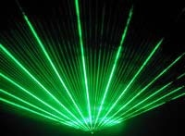
LASER
L:LIGHT
A:AMPLIFICATION by
S:STIMULATED
E:EMISSION of
R:RADIATION

Slide 3
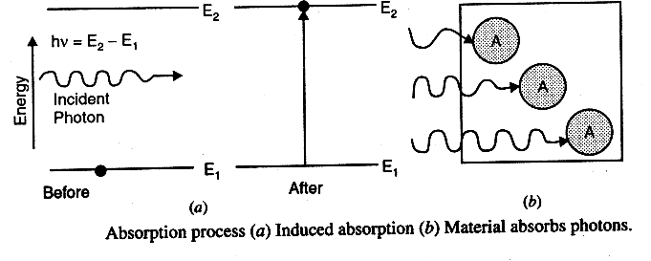
  Absorption
      In the process of absorption, energy of photon hν=E₂-E₁ ‘ absorb by atoms in the lower energy states and atom excites to higher energy states.
      Einstein Equation for absorption
  A + hν → A*
  Where A : Atom in ground state, A*: Atom in excited state
  dNab/dt = B₁₂N₁ρ(υ) , N1= No. of atom at the ground state (E1) B12 : Einstein’s coefficient of absorption
  ρ(υ) : Photon flux density

Slide 4
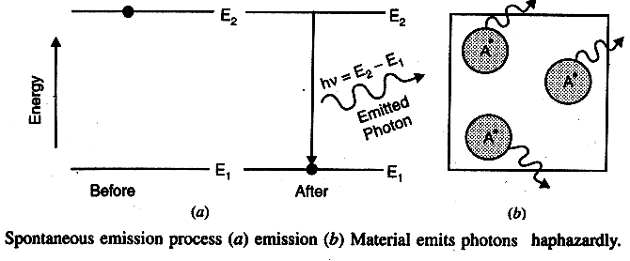
Spontaneous Emission
As the life time of the excited state is very less, atom stay there for short duration. After its life time is over, it comes to ground state with emission of photon
The process of emission of photons by an excited atoms by its own , without the influence of external agent is called spontaneous emission
A* →A + hν ⇒ Spontaneous Emission
Where A-Atom in ground state(E₁) ,
A*- Atom in excited state(E₂) A₂₁:Einstein’s coefficient of spontaneous emission
  N2= No. of atom at the exciated state (E2)
dN_{sp} /dt= A₂₁N₂

Slide 5
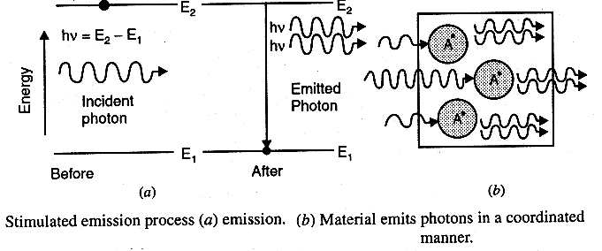
Stimulated emission
The photon induces or triggers the excited atom to make transition from excited state to ground state by releasing the energy in the form of photon ,before the atom can make a spontaneous transition
The process of emission of photons by an excited atom through a forced or triggered transition occurring under the influence of an external agent is called Stimulated emission.
A* + hν A + 2 hν
Where, B21 : Einstein’s coefficient of Stim. Emission ρ(υ) : Photon flux density
N₂= No. of atom at the exciated state (E₂)
Multiplication of photon takes place in this process. Eg. A photon produces twp photons, which stimulate the two atoms in their path and produces four photons and so on 2^{N} no. of photons are emitted from N-atoms
dN_{st} /dt= B₂₁ N₂ ρ(υ)

Slide 6
Spontaneous and Stimulated Emission
Spontaneous Emission | Stimulated Emission
It is a random and probabilistic process. | Not a random process.
The process is not controllable from outside | Controllable from outside
The resultant light is not monochromatic | Highly monochromatic
incoherent light emitted | Highly coherent
The net intensity is proportional to the number of radiating atoms, thus I _{total} = NI Where N – no. of atoms I - Intensity of light emitted by one photon. | The net intensity is proportional to the square of number of radiating atoms, thus I_{total} = N2I Where N – no. of atoms ,I - Intensity of light emitted by one photon

Slide 7

VEDIO OF PRINCIPLE OF LASER

Slide 8


Slide 9
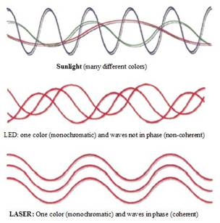
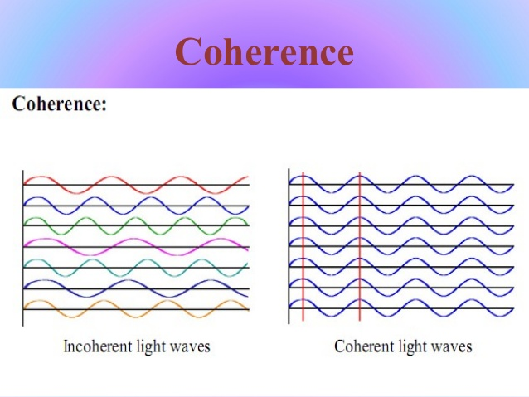
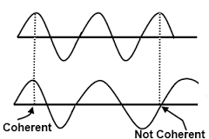
LIGHT

Slide 10
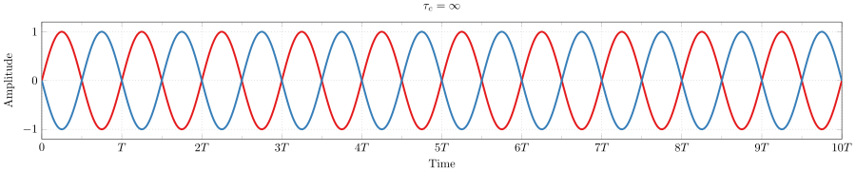
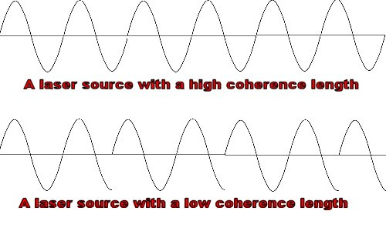
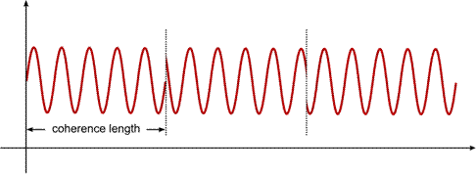
A wave which appears to be a pure sine wave for are infinitely long period of time or in an infinitely extended space, it said to be a perfectly coherent wave.
There are two type of coherence, 1) Temporal cohereance and 2) Spatial coherence
Temporal Coherance (Longitudinal coherence)
It is the phase relationship
between the radiation fields at
different time intervals
Eg. Na-light having
coherence time ~10-10sec
The average time interval for which the field remains sinusidal (i.e. definite phase relationship exists) is known as coherence time of light beam and is denoted by Δt or t_{coh}
The distance for which the filed remains sinusoidal is know as Coherence length
lcoh . = c.t_{coh} =c τ= c/ ∆ν

Slide 11
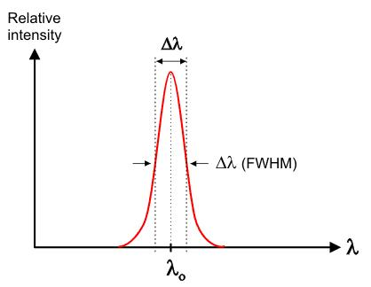
Temporal coherence and monochromaticity
Every spectral line has a finite width which means that it corresponds to a continuous distribution of wave length in some narrow interval between λ and λ +d λ
Where Δ λ - Bandwidth
Longer coherence time, smaller will be freq spread and vice versa
For perfectly short monochromatic ∆ν=0 and ∆t =∞
Example:- For NA Yellow light (λ=5893 Aº) Δטּ/ טּ =2x10⁻⁵ For LASER light Δטּ/ טּ =2x10⁻⁸
Δt = 1/ Δטּ
l_{coh}=c/∆ν= λ² / ∆ λ
Spatial coherence (Transverse Coherence)
The phase relationship between the radiation field at different
points in space is called spatial coherence.
C
S
A
B

Slide 12
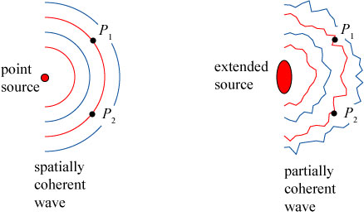
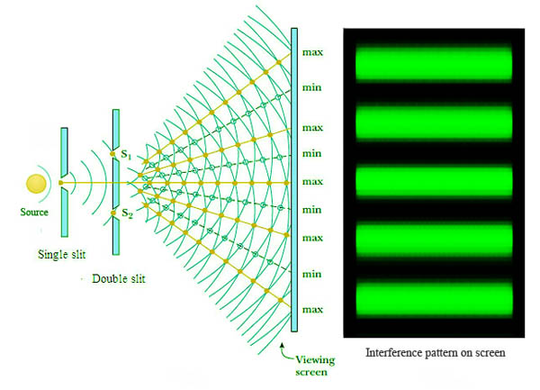
IF AB<<L, there will be a definitte phase relationship between A and B (coherance) but,
IF AB>>L, there will be not phase relationship between A and B (Incoherence)
Let us consider A and C are in same phase relationship i.e spatial coherance.
If source S is extended, the point A and C will no longer remain coherance
C
S
A
B
Ex: Young’s double slit experiment

Slide 13
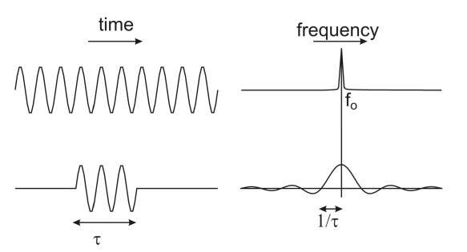
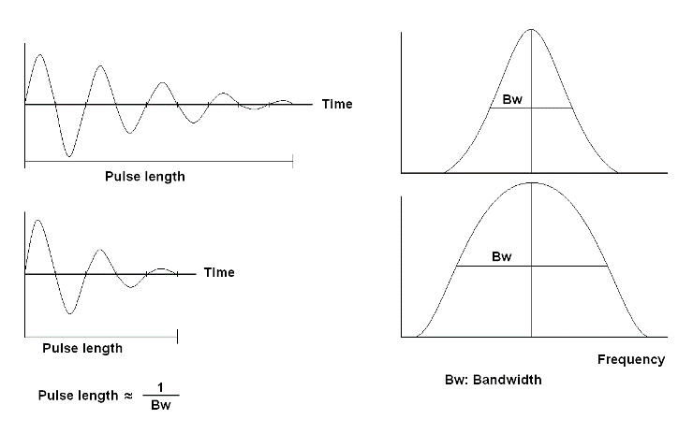
Relation between coherance length and band width(Δטּ)
If Δטּ is the frequency spread of spectral line emitted by the source then we have
τ = Δt = 1/ Δטּ
where Δt = life time of an excited state.
l_{coh} = c τ = c. ∆t = c / ∆ν,
Here broader the interval of frequencies ,
smaller is the coherence length.
We know , ν = c / λ ( ditternatiating w.r.t ‘λ’ )
∴ ∆ν = - c . ∆ λ / λ² , ignoring minus sign
l_{coh} = λ² / ∆ λ , Where Δ λ-Bandwidth
Coherence length for Fluorescent tube light
of average wavelength 5500 Aº is :
l_{coh} = λ²/ 2Δ λ = 5040 Aº
Sodium lamp l_{coh} = 0.29 mm and
For He-Ne laser, l_{coh} = 100 m

Slide 14
Characteristics of LASER light
    Highly Coherent
      Highly directional
        Small divergence
        High Intensity
        Highly Monochromatic

Slide 15
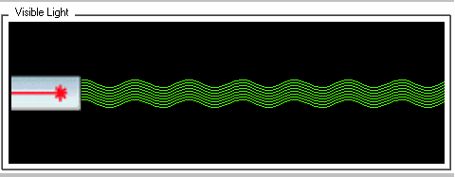
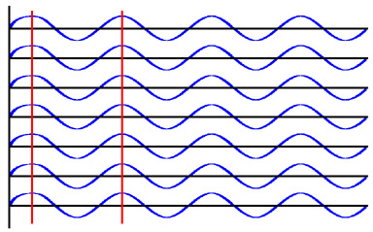
Difference between Ordinary & laser
Ordinary light Laser light
Incoherent
Different direction
High Divergence
Low Intensity
Polychromatic
Coherent
Uni- direction
Less Divergence
High Intensity
Monochromatic

Slide 16
Coherence
  Coherence refers to constant phase difference between the waves.
  Coherence is classified into two: Temporal coherence (Longitudinal coherence) and Spatial coherence (Transverse Coherence)
  Coherance length of laser is ~600km , whereas ordinary
light is of the order of few mm or cm
Directionality
The conventional light sources emit light in all directions.
Lasers emit light only in one direction . The directionality of a laser
beam expressed in terms of “ Beam Divergence”
Two parameters, which cause beam divergence
1 Size of the beam waist
2 Diffraction
Full angle divergence is given by
D is the diameter of laser’s aperture
A typical value of divergence for a He-Ne laser is; θ ≈ 10⁻³ radian.

Slide 17
Divergence
Conventional source spread out in th form of spherical wave front
and hence highly divergent
The divergence or angular spread of laser beam is extremely small
The little divergence exist is due to the diffraction of light from the
semitransparent mirror that acts as a circular aperture
Intensity
  Power output of laser may vary from a few mWs to a few kWs.
  This energy is concentrated in a beam of very small cross-section .
  Intensity of a laser beam is approximately given by
where P is the power radiated by the laser.
  In case of 1 mW He-Ne laser of wavelength, λ = 6328×10⁻¹⁰ m
  To obtain same intensity from a tungsten bulb, temperature have to be raised to 4.6×10⁶ K (normal operating temp. of bulb ~2000K)

Slide 18
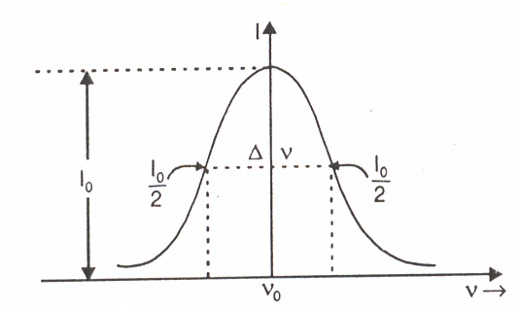
Monochromaticity
A Light source is said to be monochromatic when it emits light of single wavelength. In practice, it is not possible to produce light with only one frequency.
Light from any source consists of a band of frequencies, Δν, closely spaced around the central frequency, νo. Δν is the line width or bandwidth. Hence bandwidth is the measure of monochromaticity.
Conventional sources :
Δν ≈ 10¹⁰ Hz or more.
Light from Lasers :
Δν ≈ 100 Hz

Slide 19
Theory of laser
Interaction of Light with Matter : Quantum Mechanical view
Interaction of radiation with matter is better explained using concept of photon rather than by the wave concept.
Let photon of energy h ﬠ interact with the atoms of the material.
Consider a medium consisting of identical atoms in thermal equilibrium having;
  Energy levels E1 and E2
  Population N1 and N2 ,
  Three distinct processes can take place.
  i) Absorption
  Ii) Spontaneous emission,
  Iii) Stimulated emission

Slide 20

Conditions For Light Amplification
Light amplification requires that Stimulated emission occur almost exclusively. The laser operation is achieved when stimulated emission exceeds in a large way than the other two processes i.e. absorption and spontaneous emission.
1) Condition for Stimulated emission to dominate Spontaneous Emission
The ratio of
This indicates that Stimulated transition will dominate the Spontaneous Transition if radiation density ρ(υ) is very large.
Degree of amplification is measured as Gain which is the increase in intensity when a light beam passes through an active medium.
Gain is the amount of stimulated emission which a photon can generate as it travels in given distance.

Slide 21

Condition for stimulated emission to dominate absorption transitions
The ratio of
This condition indicates that Stimulated transition will overwhelm the absorption process if N2 is greater than N1. It means that there should be more atoms present in the higher energy level than lower energy level for stimulated emission to dominate over the spontaneous emission i.e the system must achieve population inversion state.

Slide 22
Population Inversion
In a state of thermal equilibrium there are more atoms in the lower energy level and relatively lesser number of atoms in the higher energy level which is governed by Boltzman’s equation
N₂ / N₁= e- ΔE/KT
Where ΔE = E₂-E₁ and K is Boltzmann’s constant
Population inversion is a condition in which population of upper energy level N₂ far exceeds the population of lower energy level N₁ i.e. N₂ >> N₁. The population distribution between the levels E₁ and E2 is inverted and hence it is known as population inversion condition.
Theoretically N2 >> N1 is possible if temperature is maintained negative (since ΔE > 0), Hence it is termed as negative temperature state.
N ₂
N₂
N₁
N₁
Normal State N ₂ << N₁
Thermal Equilibrium State
Inverted State N ₂ >> N₁
Population inversion State

Slide 23
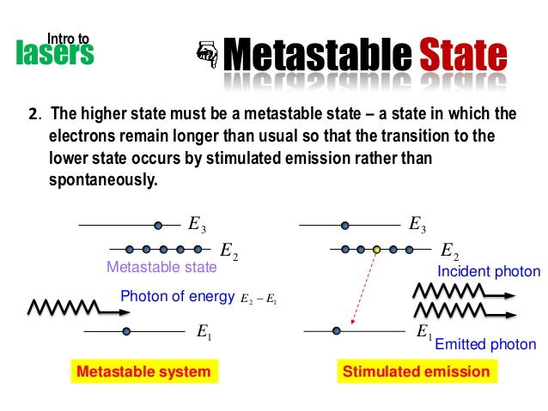
Metastable state can be defined as a state where excited atom can remain for longer time than the normal excited state, 10⁻⁹.
Atoms stay in metastable states for about 10⁻⁶ to 10⁻³s. This is 10³ to 10⁶ times longer than the time of stay of atom at excited levels.
If the metastable states do not exist, there could be no population inversion, no stimulated emission and hence no laser operation.

Slide 24
VEDIO OF PRINCIPLE OF LASER-
PUMPING AND METASTALBE STATE

Slide 25
Components of Laser
The essential components of Laser are
An active medium
A pumping agent
Optical Resonator
An active medium
A medium in which light gets amplified is called an active medium.
The medium may be solid , liquid or gas.
Out of different atoms in the medium, only a small fraction of a atoms of a particular species are responsible for stimulated emission they are called active centers.
Where R is Coefficient
of reflection
Components of Laser

Slide 26
Pumping
The process of supplying energy to the medium with a view to transfer it into the state of population inversion is known as pumping
There are number of techniques for collection of atoms to an inverted state
Optical pumping (used in Ruby Laser)- SOLID STATE LASER
Electric discharge (used in He-Ne Laser )- GAS LASER
Direct Conversion (used in Semiconductor Laser)
Fabry - Perot optical resonator (Resonant cavity)
  Optical resonator consist of two opposing plane parallel mirrors,
  with an active material placed in between them.
  One of the mirror is semitransparent while the other is 100 % reflecting.
  The mirrors are set normal to optic axis of the material.
100 % reflecting mirror
Semi-transparent mirror
Active medium
Optic axis

Slide 27
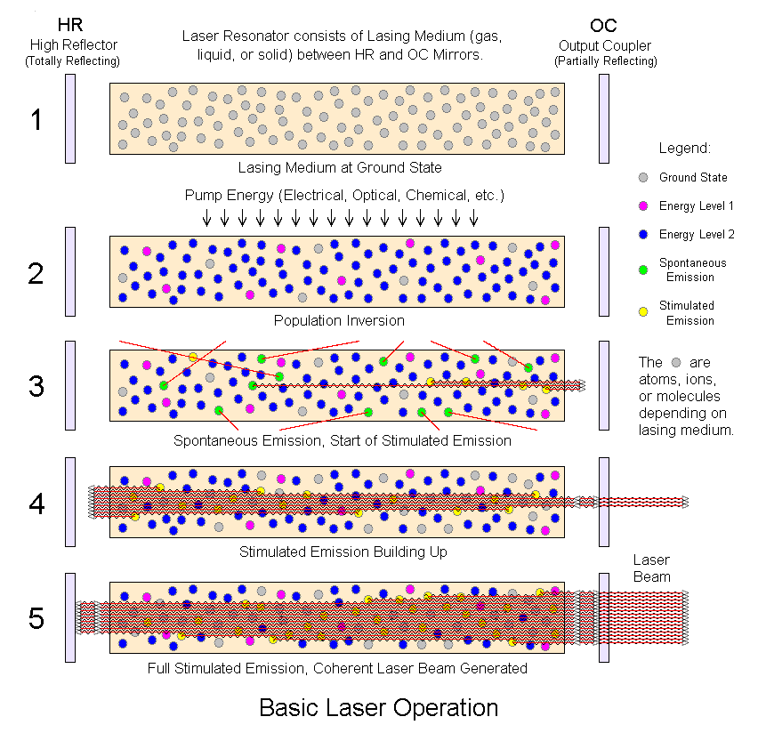
Action of Optical Resonator

Slide 28
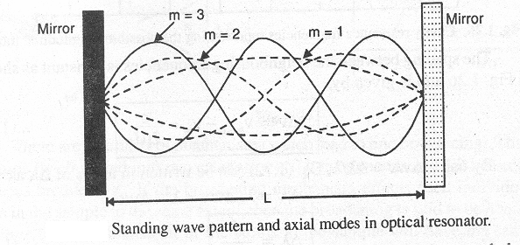
Condition for Steady State Oscillation
For waves making a complete round trip inside the resonator, phase delay must be some multiple of 2π.
2μL = m λ ; ( m = 1,2,3,…)
where μ refractive index of active medium
m modes of propagation , 2 μL – optical path.
Length L of the resonator should accommodate an
integral number of standing half waves

Slide 29

PRODUCTION OF LASER

Slide 30
Pumping Schemes
Pumping Schemes are Classified as:
Two-level,
  Three-level and
    Four –level schemes.
Two-level scheme will not lead to laser action.
Three-level and four-level schemes are important and widely employed.

Slide 31
Two Level Pumping Scheme
Population inversion is achieved by applying intense radiation and pumping an excess of atoms into the higher energy state. A two-level pumping scheme is not suitable for attaining population inversion
For such system, to excite atoms, pump source should be highly monochromatic.
In practice, monochromatic source of required frequency may not exist.
Even if it exists, the pumping efficiency would be very low ⇒ enough population cannot be excited to level E₂.
Further, pumping radiation on one hand excites the ground state atoms and on the other hand induces transitions from the upper level to the lower level means that pumping operation simultaneously populates and depopulates the upper level.
Hence, population inversion cannot be
  attained in a two-level pumping scheme
E₂
Energy
E₁

Slide 32
Three Level Pumping Scheme:
Pumping energy raises atoms from E₁ to E₃ .
From E₃ atoms comes to E₂ by
non-radiative transition.
Atoms accumulate at level E₂.
Population N₂ at E₂exceeds the population N₁ at E₁ and Population Inversion is attained.
A photon of hν=(E₂-E₁) can induce stimulated emission and triggers laser action
Major disadvantage of a three level scheme ⇒ Efficiency is less
Output ⇒ Pulsating beam
Absorption band
E
Non-radiative transition
E₃
E₂
Metastable state
E
Laser transition
Ground state
E₁

Slide 33

Four Level Pumping Scheme:
Pumping raises the atoms from E₁ to E₄. From E₄ atoms comes to E₃.
Population at E₃ exceeds the population at E₂ and population inversion is attained.
Laser transition takes the atoms
from level E₃ to the level E₂.
finally reach the ground state E₁
Four level lasers are more
efficient.
Four level lasers can operate in a Continuous Wave mode.
E₄
Non radiative transition
E₃
Stimulated Emission of Radiation
Pumping
E₂
Natural depletion
E₁
Ground State

Slide 34
Types of LASER
  Solid-state lasers- have lasing material distributed in a solid matrix . Ruby, Neodymium: Yttrium-aluminum garnet “Nd:YAG“, Nd:Glass lasers etc
  Gas lasers- He-Ne, He-Cd, CO₂, N₂ lasers etc
  Excimer lasers- (the name is derived from the terms excited and dimers) use reactive gases, mixed with inert gases such. When lased, the dimer produces light in the ultraviolet range
  Dye lasers- use complex organic dyes in liquid solution as lasing media. Rhodamine 6G, Coumarin dyes etc. They are tunable over a broad range of wavelengths (0.3 to 1.3μm).
  Semiconductor lasers ( diode lasers)-These electronic devices are generally very small and use low power. GaAs, GaAsP

Slide 35
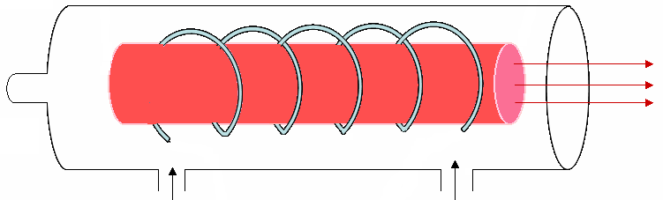

Ruby Laser
First solid state laser developed in 1960 by T.H. Maiman
Ruby laser rod; a synthetic Ruby crystal :Al₂O₃ doped with Cr³⁺
ions Cr³⁺ ions concentration= 0.05%
Fully Silvered Mirror
A helical Photographic flash lamp filled with Xenon
Partially silvered Mirror
0.5 cm
4 cm
Coolant
Inlet
Outlet
H. V. Power Supply
Ruby Laser

Slide 36

Energy level Diagram (Ruby Laser)
E₃’
Cr³⁺ atom absorb green and blue bands of wave length from xenon flash lamp & excited to E₃ & E₃’ respectively
Atoms from E₃ & E_{3’} jump to E₂ level by Non radiative transition .
Population Inversion is achived between E₂ and E₁.
Radiative transitions from E₂ to E₁ emit ⇒ Red photon with peak near 6943 A⁰ .
Non radiative transition
E₃
Metastable state
E₂
Stimulated emission
Green
Energy (ev)
Blue
Pumping
E₁
Ground state

Slide 37
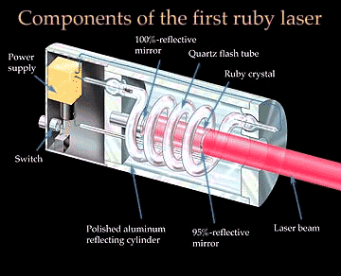
Ruby Laser

Slide 38
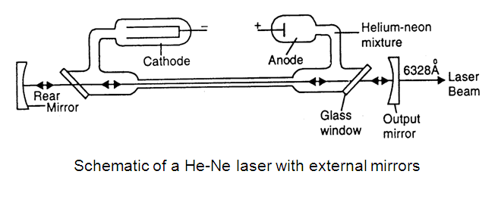
He-Ne laser
First gas laser was developed in 1961 by Ali Javan and his coworkers
Discharge tube of about 50 cm long, 1 cm in diameter, filled with a mixture of He & Ne gases in 10:1 which is active medium.
Ne-atoms are active centers- have energy levels suitable for laser transitions
He-atoms help efficient excitation of Ne-atoms
Electrodes connected to HV power supply to produce discharge in gas.
High voltage of 10 kV applied across the electrodes ionizes the gas.
Energy transfer between He and Ne-atom takes place through collision, excites Ne atoms

Slide 39
Energy Transfer Through Atomic Collisions
Laser transition
Helium
Neon
F₃
E₆
20.61eV
20.66eV
3.39 µm
E₅
F₂
E₄
6328Å
1.15 µm
E₃
Energy
Spontaneous emission (6000Å)
E₂
Excitation by collision with electrons
De-excitation by collision with walls
F₁
E₁
Energy levels of Helium and Neon atoms and transitions between the levels.

Slide 40
He-Ne laser
He atoms are excited to levels F₂ &F₃ – metastable levels
E₄ & E₆ levels in Ne are metastable states ⇒ accumulation of atoms takes place in level E₆ and E₄
Population inversion can be achieved between:E₆ and E₅, E₆ and E₃ levels E₄ and E₃ levels
E₆ →E₃ transitions; laser beam of red color at 632.8 nm (6328 A)
E₄ →E₃ transitions; laser beam at wavelength of 1150 nm(11500 A )
E₆ →E₅ transitions; laser beam in IR region at 3390nm(33900 A)
E₂ →E₁ transition induced by collisions with walls of discharge tube.
Therefore discharge tube is made as narrow as possible to enhance probability of atomic collisions with walls.
In most of applications He-Ne lasers is used as a source of red light.
Power output from He-Ne laser is 1- 50 mW.

Slide 41
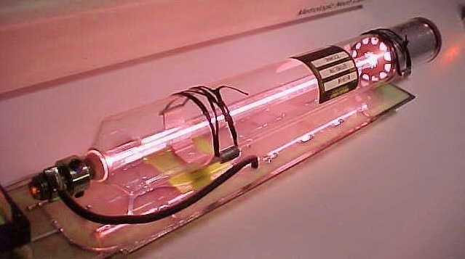
He-Ne laser
Courtesy of Metrologic, Inc.
Laser-Professionals.com
Notes:
41
Gas lasers use gas atoms in a tube as an active medium. The excitation mechanism is usually an electric current through the gas. The current excites gas atoms to the correct energy level for lasing to occur. Mirrors on each end of the tube are aligned to reflect the laser beam through the active medium. About 2% of the light passes through the output coupler at the lower left.
This photo is a typical 5 mW HeNe laser. This was the most common type of laser until the mid 1980s when reliable, low-cost diode lasers became available. HeNe lasers are still the second most common lasers. They provide higher beam quality than most diode lasers. They are widely used in scientific applications where low power, high quality beams are needed.
There are many other types of gas lasers. Argon lasers produce powerful blue beams and are used in scientific research, medical applications, and laser light shows. Carbon dioxide lasers produce beams with powers of thousands of watts and are used for cutting and welding metals. Other gas lasers find a wide range of applications.

Slide 42

HE-NE LASER

Slide 43
Semiconductor Laser
R.N. Hall and his coworkers made the first semiconductor laser in 1962.
A semiconductor diode laser is a specially fabricated p-n junction device that emits coherent light when it is in forward biased.
Current flow
Active region
Roughened surface
Optically flat and
parallel faces
P type
Laser output
N type
Optically flat and parallel faces

Slide 44
Semiconductor Laser
Semiconductor laser is heavily doped PN junction diode
Direct band gap semiconductor, like GaAs, GaAsP used in semiconductor laser
Junction lies in horizontal plane top and bottom faces are metalized to provide electrical contact.
The end faces are made optically flat and silver coated.
Polished faces formed resonant cavity.
When diode is forward biased electron from C.B. recombine with holes in V. B.
During recombination it emits energy in the form of light and junction acts as laser which emites coherence beam of laser light
At low FB. Junction acts as a LED which emits incoherent light
A GaAsP laser emits light of wavelength 9000 Aº in IR region (red)
.
Notes:
44
Gas lasers use gas atoms in a tube as an active medium. The excitation mechanism is usually an electric current through the gas. The current excites gas atoms to the correct energy level for lasing to occur. Mirrors on each end of the tube are aligned to reflect the laser beam through the active medium. About 2% of the light passes through the output coupler at the lower left.
This photo is a typical 5 mW HeNe laser. This was the most common type of laser until the mid 1980s when reliable, low-cost diode lasers became available. HeNe lasers are still the second most common lasers. They provide higher beam quality than most diode lasers. They are widely used in scientific applications where low power, high quality beams are needed.
There are many other types of gas lasers. Argon lasers produce powerful blue beams and are used in scientific research, medical applications, and laser light shows. Carbon dioxide lasers produce beams with powers of thousands of watts and are used for cutting and welding metals. Other gas lasers find a wide range of applications.

Slide 45
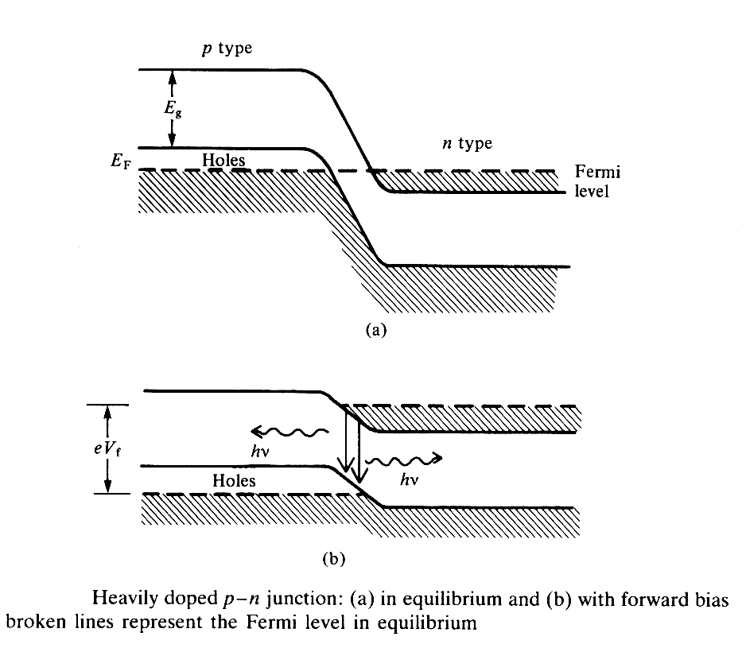
Energy band structure of a semiconductor diode
The equilibrium and forward biased energy band diagrams for a junction formed from such degenerate materials with direct energy gap is shown.
When the junction is forward biased with a voltage that is close to the energy gap, electrons and holes are injected across the junction in sufficient numbers to cause population inversion.
The population inversion is created in a very narrow zone called the active region
The stimulated electrons - holes recombination cause emission of coherent radiation of very narrow bandwidth .

Slide 46
Semiconductor diode laser

Slide 47
Semiconductor diode laser

Slide 48
Applications of LASER
Industrial applications –
Drilling, welding, cutting of very hard substances, including steel and diamond
Applications in the field of medical science – Welding of detached retinas, correction of vision defects, surgery, treatment of skin cancer
Astronomical and geophysical applications – Precision survey and long-range distance measurement
Metrology applications – Measurements standards and Instrumentation
Applications in communication – One laser beam could carry as much as information as all existing radio channels
Defense application –
Ranging, Anti missile shield, laser detonators, instruments, spying and in war time
Environmental monitoring and Scientific Research –
RADAR , LIDAR , Speckles and Holography

Slide 49
HOLOGRAPHY APPLICATION
A hologram can also be with sound waves and other waves in the electro-magnetic spectrum.
Holograms made with X-rays or ultraviolet light can record images of particles smaller than visible light, such as atoms or molecules.
Microwave holography detects images deep in space by recording the radio waves they emit.
Acoustical holography uses sound waves to "see through“ solid objects.
Notes:
49

Slide 50
LASER APPLICATION EXAMPLES
HOLOGRAPHY
Notes:
50

Slide 51
HOLOGRPHY APPLICATION EXAMPLES
DISPLAY HOLOGRAM: EXHIBIT
Notes:
51

Slide 52
3D HOLOGRAPHY
3D HOLOGRAPHY

Slide 53
3D IMAGE

Slide 54
7D HOLOGRAPHY
7D HOLOGRAPHY

Slide 55
FUTURE HOLOGRAPHY

Slide 56
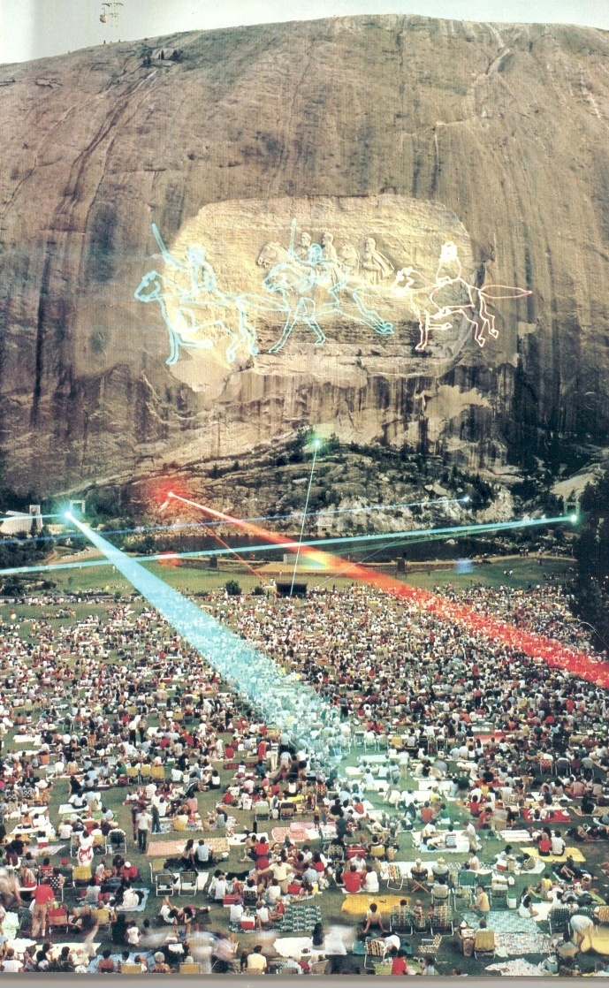
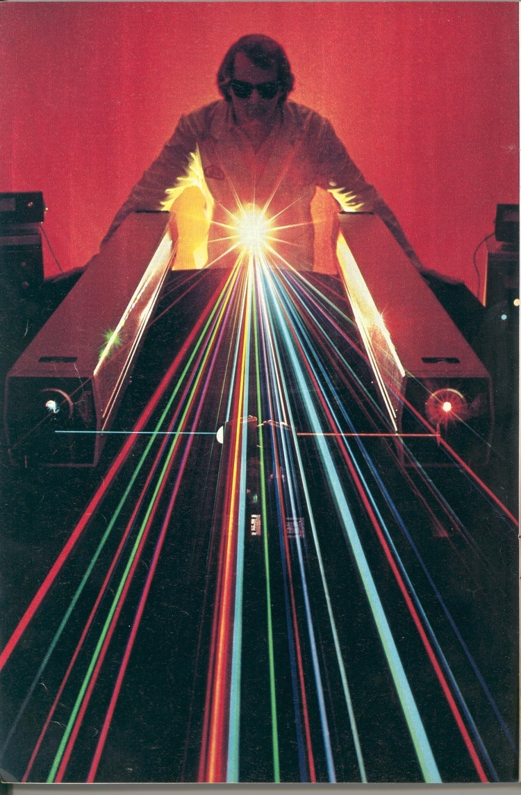
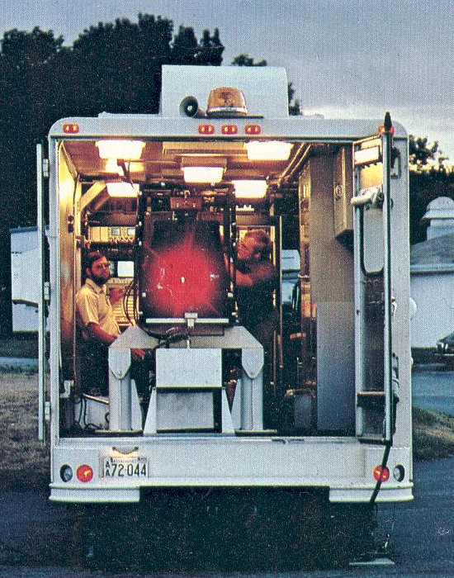
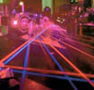
LASER APPLICATION EXAMPLES
Laser show
ENTERTAINMENT APPLICATION
Notes:
56

Slide 57
LASER CUTTING
TECHNOLOGY

Slide 58
LASER WELDING TECHNOLOGY

Slide 59
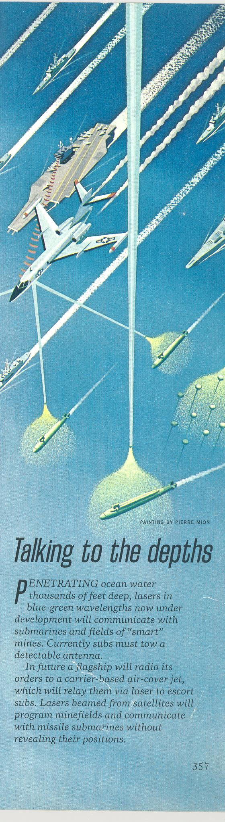
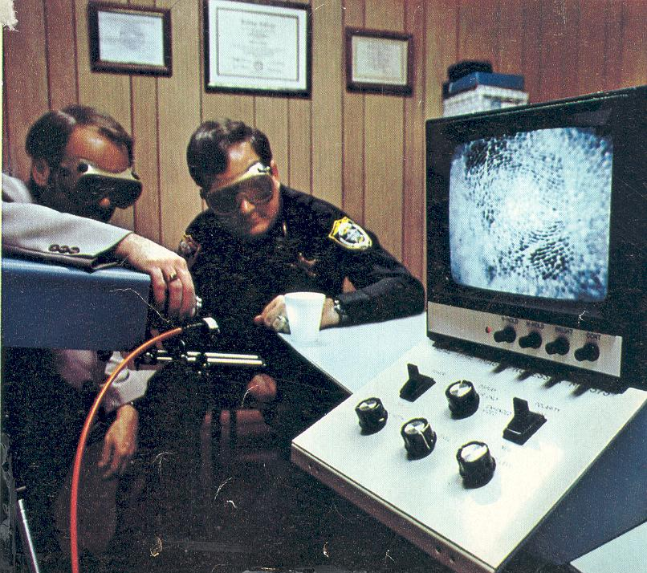
LASER APPLICATION EXAMPLES
Finger print detection
Detection of submarine and mines
DEFENSE APPLICATION
Notes:
59

Slide 60
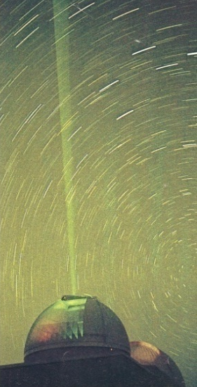


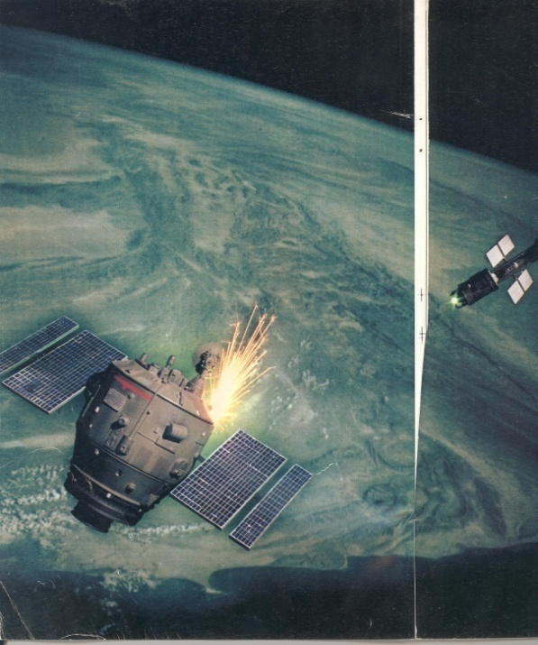
LASER APPLICATION EXAMPLES
Laser at war time
DEFENCE APPLICATION
Notes:
60

Slide 61
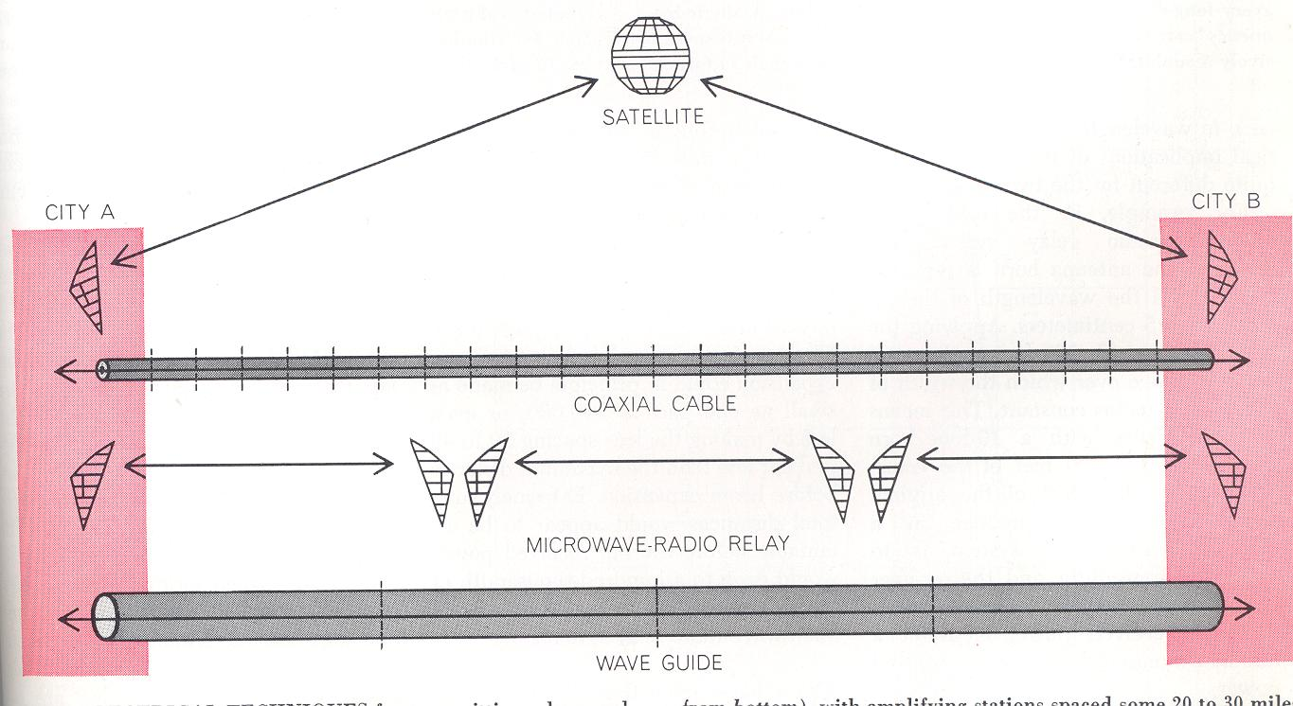
LASER APPLICATION EXAMPLES
Frequency in the visible region ~ 10¹⁴ cycle/sec
Frequency in the microwave region ~ 10⁹ cycle/sec
i.e. communication capacity: light wave 10⁵ > microwave
OPTICAL COMMUNICATION
Notes:
61

Slide 62
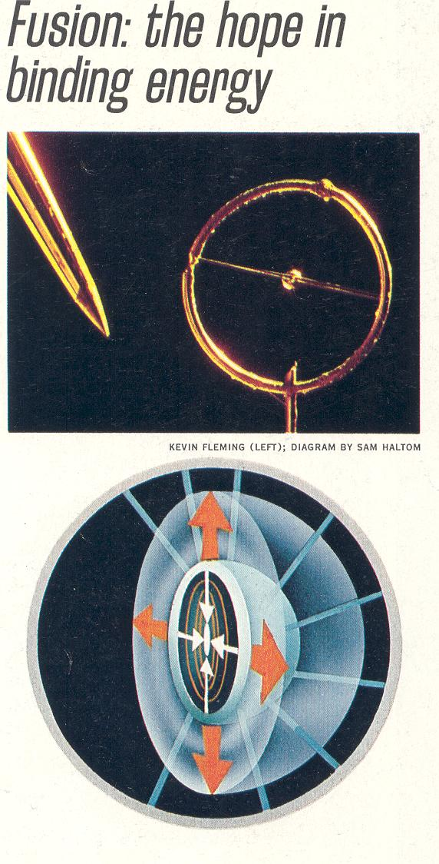
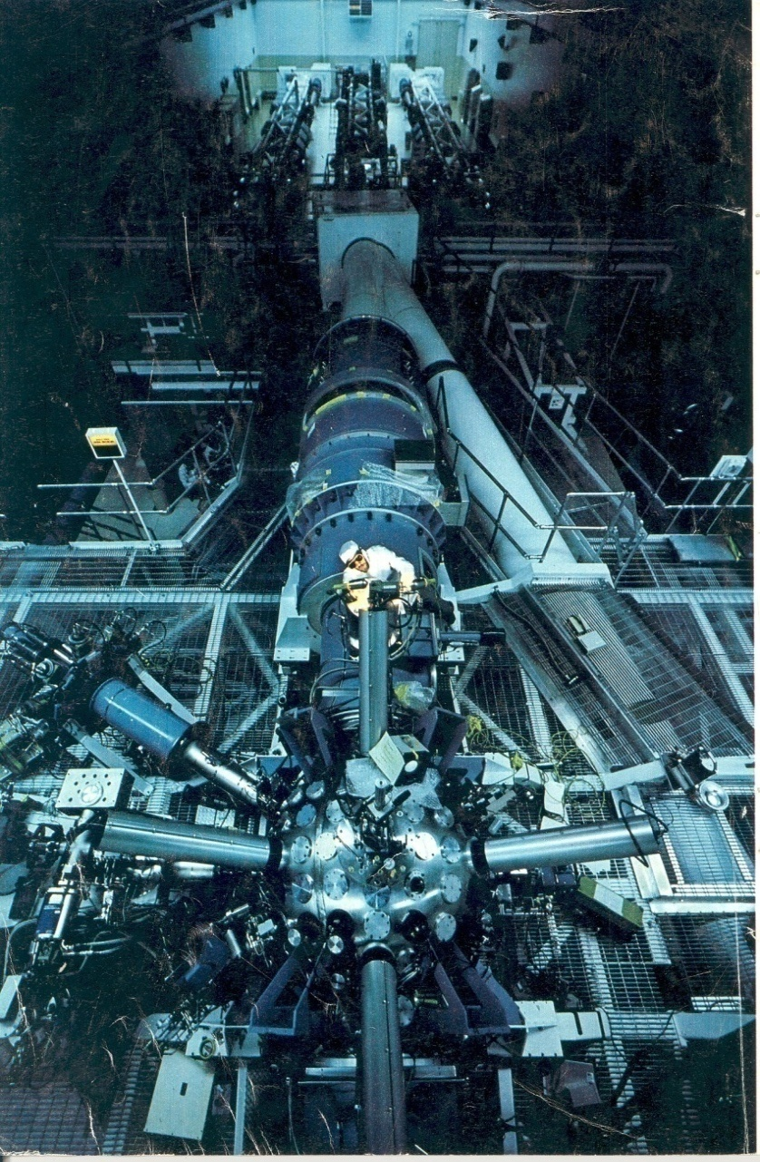
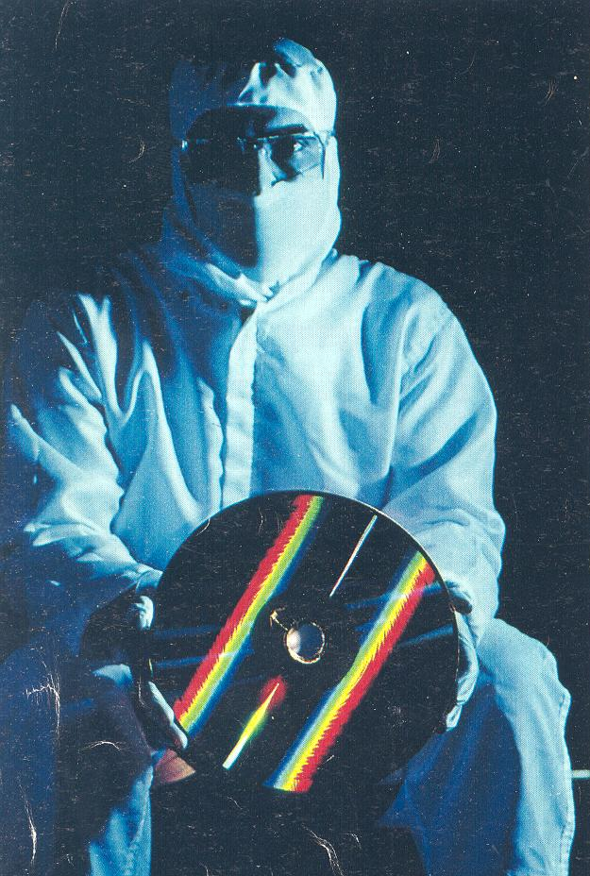
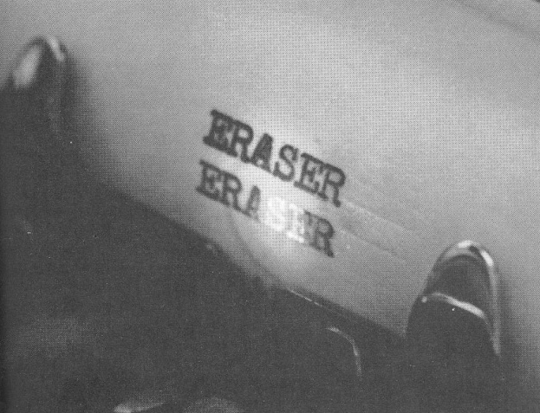
LASER APPLICATION EXAMPLES
Laser fusion
Laser Eraser
Compact Disk (CD)
SCIENCE AND TECHNOLOGY
Notes:
62

Slide 63
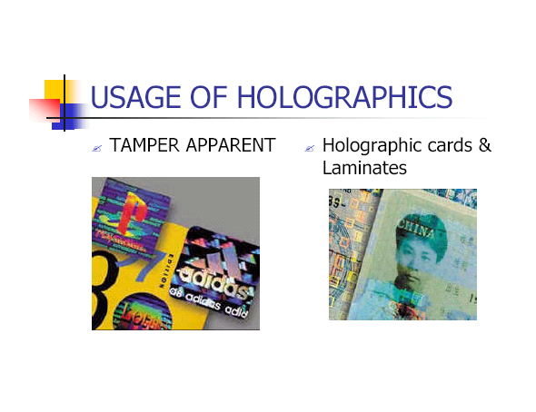


HOLOGRPHY APPLICATION EXAMPLES
An Embedded Hologram™ cannot be removed, erased, duplicated or simulated by photocopying, photography or scanning.
SECURITY HOLOGRAM
Notes:
63

Slide 64
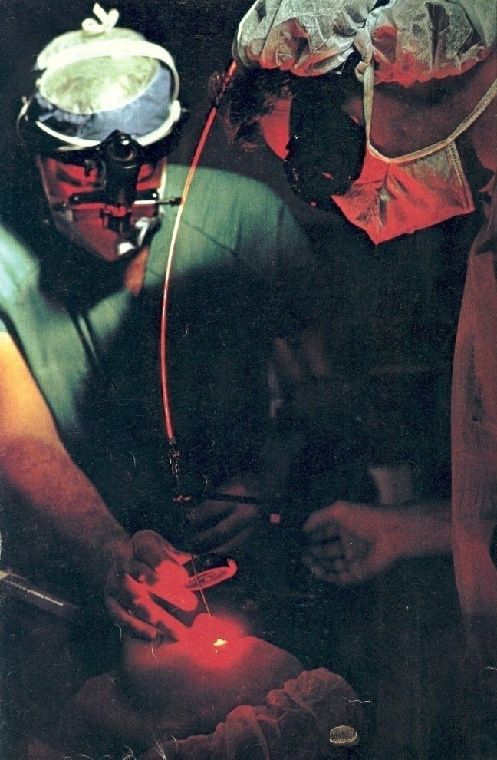
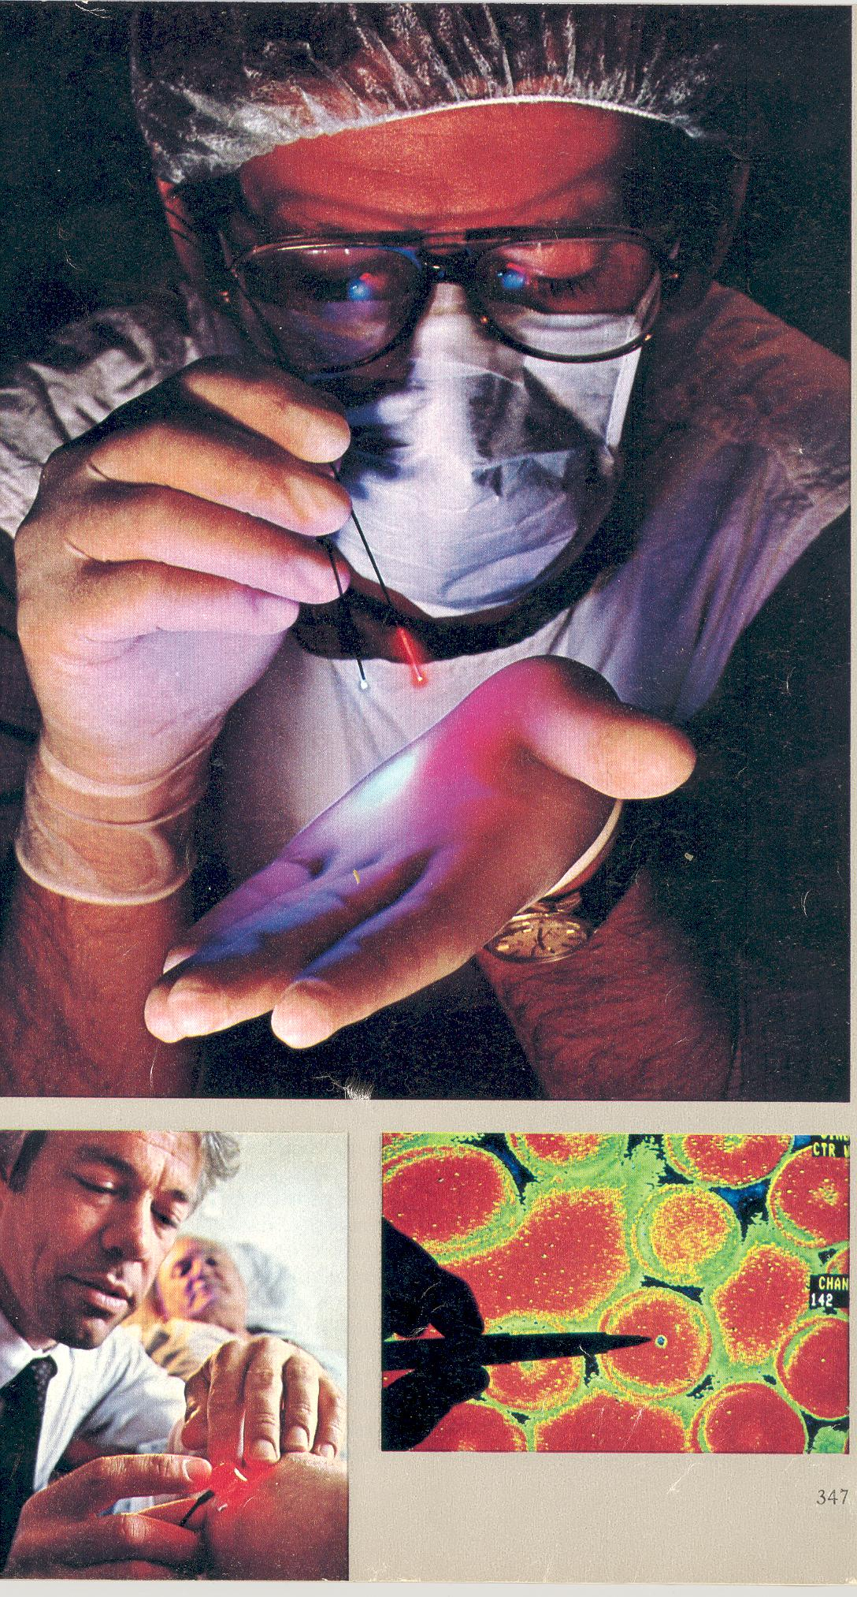
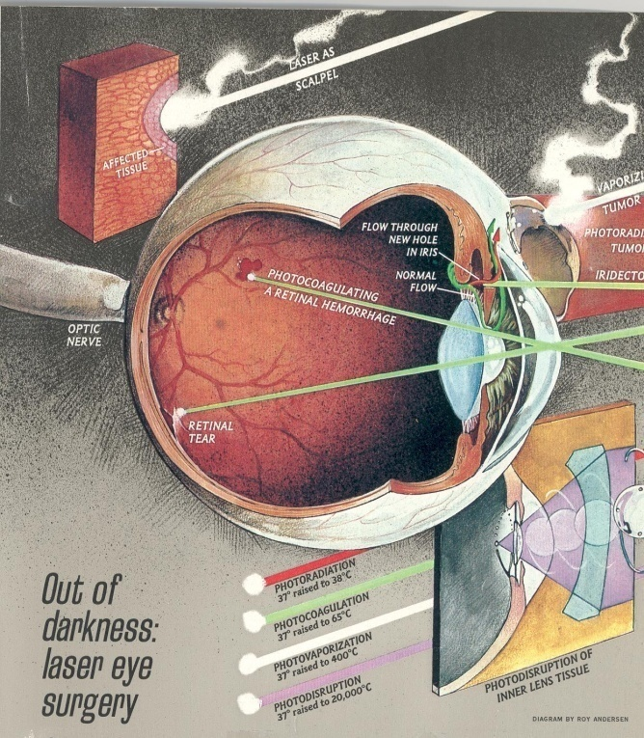

LASER APPLICATION EXAMPLES
Brain tumor surgery
Eye surgery
MEDICAL APPLICATION
Notes:
64

Slide 65
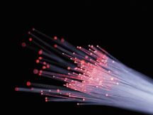
Fibre Optics

Slide 66
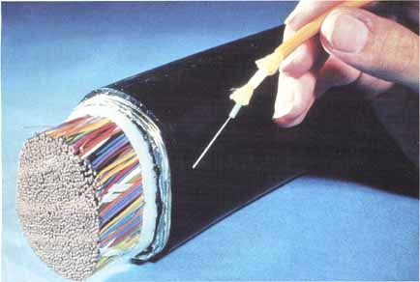
Fibre optics
An optical fiber (or fibre) is a glass or plastic conduit as thin as human hair designed to guide light waves along its length based on the principle of total internal reflection.

Slide 67
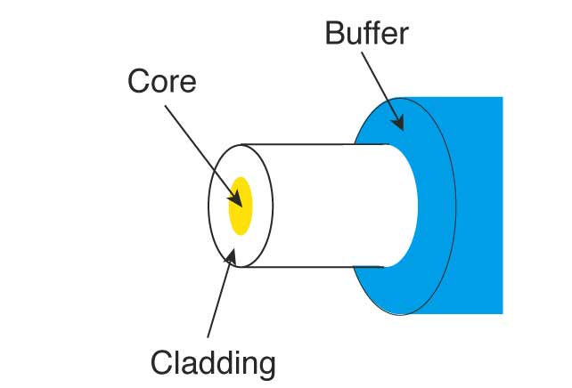
Main sections of optical fibers:
Core - Thin glass/plastic center of the fiber where the light travels
Cladding – core is surrounded with optical material glass/plastic that reflects the light back into the core (RI is less than core)
Buffer coating(Sheath) - Plastic coating that protects the fiber from damage and moisture. It increases the mechanical strength of the fiber
fiber core
glass or plastic
cladding
Plastic jacket

Slide 68
Structure of optical fibre
Sheath
Cladding
250 -900µm
Core
≈ 8-60µm
125 µm

Slide 69
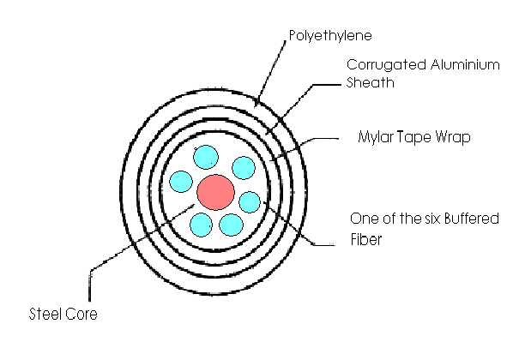
Multifiber Cable

Slide 70
Principle of operation of optical fibre
Fibre optics works on the principle of Total Internal
Reflection.
When light enters one end of the fibre, it undergoes
successive Total Internal Reflections from the side
walls and travels down the length of the fibre along
zigzag path.

Slide 71
Total internal reflection
Total internal reflection is an optical phenomenon that occurs when a ray of light strikes a medium boundary (core-cladding ) at an angle larger than the critical angle with respect to the normal to the surface.
As the R.I. of cladding is lower than core, the light is reflected in the core medium .
The critical angle is the angle of incidence above which the total internal reflection occurs.

Slide 72
Total internal reflection
Total internal reflection is an optical phenomenon that occurs when a ray of light strikes a medium boundary (core-cladding ) at an angle larger than the critical angle with respect to the normal to the surface.
µ₁ > µ₂
Where µ₁ is the refractive index of denser medium and µ₂ is the refractive index of rarer medium.
When light passes from rarer to denser medium, it is bent towards the normal in denser medium.
When light passes from denser to rarer medium, it is bent away from the normal in rarer medium.
1
Normal
2
3
θ₂
µ₂
4
θ1
5
µ₁

Slide 73


Snell’s law may be written as:
When θ₂ = 90º,
  = Sin θ_{c}
1
Normal
2
3
θ₂
µ₂
4
θ1
5
The angle of incidence for which the angle of refraction is 90⁰ is known as critical angle θ_{c}.
µ₁

Slide 74
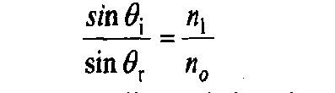
Propagation of light through a cladded fibre:
Normal
B
θ_{i}
θ_{c}
n₁
Launching medium air
θr
totally internally reflected ray
A
C
θ_{i}
Core
_{Incident} ray
n₂
Cladding

Slide 75

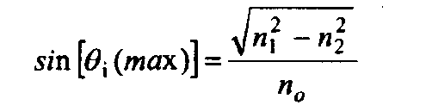

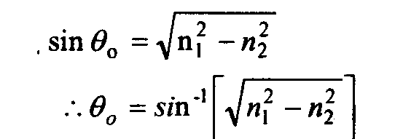
Derivation
Applying Snell’s law to the launching face of the fibre, we get
----------------------- (1)
Applying Snell’s law to the core-cladding interface of the fibre, we get
------------------ (2)
Using equation (1) & (2)
We get
Here the incident ray is launched from air medium, for which n₀= 1.
The angle θ₀ is called the acceptance angle of the fibre.
-

Slide 76

Propagation of light through a cladded fibre:
Acceptance Angle is defined as the maximum angle that a light ray can have relative to the axis of the fibre and propagate down the fibre.
θ₀ = sin⁻¹[ n₁² - n₂² ]^{1/2}
It depends on core diameter and the material.
Acceptance cone:- It is twice of the acceptance angle i.e. 2θ₀.

Slide 77

Numerical Aperture
Numerical Aperture is defined as the sine of the acceptance angle.
It determines the light gathering ability of the fibre.
It measures the amount of light accepted by the fibre.
Where ∆ -Fractional refractive index change
Fractional refractive index change
Fractional refractive index change is the fractional difference between the refractive indices of the core and the cladding.
This parameter is always positive because n₁ > n₂
In order to guide light rays effectively through a fibre, Δ << 1

Slide 78
Modes of propagation:
Modes are the possible number of paths of light in an optical fibre.
Light propagates as an electro-magnetic wave through an optical fiber, thus the waves travel in number of directions and not all waves are trapped within the optical fibre.
The allowed directions corresponds to the modes in optical fibre .
The light rays traveling through a fibre are classified as
1. Axial rays
2. Zigzag rays.

Slide 79
Classification of Optical Fibre
Optical Fibre
On the basis of refractive index profile
On the basis of light propagation
On the basis of materials
Step index fibre
Graded index fibre
Glass fibre
Plastic fibre
PCS (polymer clad silica)
Single mode fibre (SMF)
Multimode fibre (MMF)

Slide 80

Single mode and Multimode
Single mode fiber has a core diameter of 8 to 9 µm which only allows one light path or mode along the axis of optical fibre.
∆ and NA are very small. As NA is small , acceptance angle is also very small therefore light coupling into the fibre becomes difficult.
Index of refraction

Slide 81

Multimode Step-Index Fiber
Multimode fiber has a core diameter of 50 or 62.5 µm (sometimes even larger)
  Allows several light paths or modes
  This causes modal dispersion – some modes takes longer time to pass through the fiber than others because they travel a longer distance
Index of refraction

Slide 82

Multimode Graded-Index Fibre
The index of refraction gradually changes across the core
Modes that travel further also move faster.This reduces modal dispersion so the bandwidth is greatly increased.
Index of refraction

Slide 83
Classification on the the basis of material used for fabrication of optical fibre
Glass fibres: 1) SiO₂ core – B₂O₃.SiO₂ cladding
2) GeO₂.SiO₂ core – SiO₂ cladding
Plastic fibres: 1) Polystyrene core n₁ = 1.60 NA = 0.60
- Methyl methacrylate core n₂ = 1.49
2) Polymethyl methacrylate core n₁ = 1.49 NA = 0.50
- cladding made of its copolymer n₂ = 1.40
PCS fibres: The core is made from high purity quartz. The cladding is made of a silicone resin having a refractive index of 1.405 or of perfluoronated ethylene propylene (Teflon) having a refractive index of 1.338. The PCS fibres are less expensive but have high losses. They are mainly used in short distance applications.

Slide 84
V-number or Normalized frequency:
The number of modes allowed in a given fiber is determined by a relationship between the wavelength of the light passing through the fiber, the core diameter of the fiber, and the material of the fiber. This relationship is known as the Normalized Frequency Parameter, or V number.
The mathematical description of the V number is:
V = 2 Π* NA * a / λ
Where NA = numerical aperture
a = fiber core radius (microns)
λ = wavelength (microns)
For V < 2.405, the fibre can support only one mode.
For V > 2.405, the fibre can support many modes simultaneously.
For V=2.405, the wavelength is called cut-off wavelength.

Slide 85
Advantages of optical Fibre
Cheaper
Smaller in size, lighter in weight, flexible yet strong
Not hazardous
Immune to EMI(electromagnetic interference) and RFI(radiofrequency interference)
No cross talk
Wider bandwidth
Low loss per unit length

Slide 86
Losses
Losses in optical fibre result from attenuation in the material itself and from scattering, which causes some light to strike the cladding at less than the critical angle.
Bending the optical fiber too sharply can also cause losses by causing some of the light to meet the cladding at less than the critical angle
Losses vary greatly depending upon the type of fiber
  Plastic fiber may have losses of several hundred dB per kilometer
  Graded-index multimode glass fiber has a loss of about 2–4 dB
  per kilometer
  Single-mode fiber has a loss of 0.4 dB/km or less

Slide 87

ATTENUATION:
As a light signal propagates through a fibre, it suffers loss of amplitude and change in shape. The loss of amplitude is referred to as attenuation and the change in shape as distortion.
The attenuation of optical signal is defined as the ratio of the optical input power from a fibre of length L to the optical output power. It is expressed in decibel per kilometer (dB/Km).
P_{i} is the power of optical signal launched at one end of the fibre
P₀ is the power of the optical signal emerging from the other end of the fibre.
In case of an ideal fibre, P₀ = P_{i}, and the attenuation would be zero.

Slide 88


Mechanisms of Attenuation:
The loss mechanism broadly divided into two categories:
Intrinsic losses: These are influenced by the material composition and purification level.
1) Absorption by material
2) Rayleigh Scattering
B) Extrinsic losses: These are caused by geometric effects. Any bends in the optical fibre produce radiative losses.
1. Microbend losses:
2. Macrobend losses:

Slide 89

DISPERSION
change in shape of signal .
There are three mechanisms in the dispersion of the light pulse in a fibre. They are known as
(i) material dispersion,
(ii) waveguide dispersion and
(iii) intermodal dispersion.

Slide 90

Application of fibre optics
1) Force Sensor/Pressure Sensor
Principle: Force sensor is based on variations of light intensity. When an optical fibre is pressed, a small change occurs in light propagation direction due to microbending of the fibre. As a result, energy from one mode is transferred to another mode through mode coupling. All these effects cause a change in intensity of the light transmitted through the fibre. Therefore, the change in intensity of the transmitted light is proportional to the force applied on the optical fibre.

Slide 91

2) Temperature sensors
Principle: In this type of sensor, temperature is measured by the modulation of intensity of the reflected light from a target, a silicon layer. The operation of the temperature sensor is based on the 1¼ m wavelength light-absorption characteristics of silicon as a function of temperature. Depending on the temperature. the amount of light absorbed by the silicon layer varies. The change in intensity of the reflected light is proportional to the change in temperature.

Slide 92

Optical fibre Submarine Cables
Thank You

